Slide 1
Cloud Deployment and service models
Prepared By:
AVITA KATAL
Assistant Professor
Systemics Cluster
SCS,UPES

Slide 2
contents
Cloud Reference Models(Service/Delivery models)
1.1. Infrastructure As a Service(IaaS)
1.2. Platform as a Service(PaaS)
1.3. Software as a Service(SaaS)
2. Deployment Models
2.1 Public Cloud
2.2. Private Cloud
2.3. Hybrid Cloud
2.4. Community Cloud

Slide 3
1. Cloud Reference model
A broad definition of the phenomenon could be as follows:
Cloud computing is a utility-oriented and Internet-centric way of delivering IT services on demand. These services cover the entire computing stack: from the hardware infrastructure packaged as a set of virtual machines to software services such as development platforms and distributed applications.
This definition captures the most important and fundamental aspects of cloud computing. We now discuss a reference model that aids in categorization of cloud technologies, applications, and services.

Slide 4
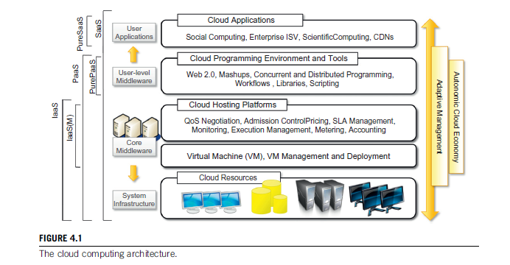
1. Cloud Reference model contd…
Cloud computing supports any IT service that can be consumed as a utility and delivered through a network, most likely the Internet. Such characterization includes quite different aspects: infrastructure, development platforms, application and services.

Slide 5
Cloud Reference model contd…
Infrastructure as a service
System Infrastructure:
This layer is using a data center in which hundreds and thousands of nodes are stacked together.
Cloud infrastructure can be heterogeneous in nature because a variety of resources, such as clusters and even networked PCs, can be used to build it.
Moreover, database systems and other storage services can also be part of the infrastructure.
Core Middleware:
The physical infrastructure is managed by the core middleware, the objectives of which are to provide an appropriate runtime environment for applications and to best utilize resources.
Bottom of the stack has virtualization technologies which are used to guarantee runtime environment customization, application isolation, sandboxing, and quality of service.
Hardware virtualization is most commonly used at this level. Hypervisors manage the pool of resources and expose the distributed infrastructure as a collection of virtual machines.
Virtualization Technology makes it possible to finely partition the hardware resources such as CPU and memory and to virtualize specific devices, thus meeting the requirements of users and applications
The combination of cloud hosting platforms and resources is generally classified as a Infrastructure-as-a-Service (IaaS) solution. We can organize the different examples of IaaS into two categories: Some of them provide both the management layer and the physical infrastructure; others provide only the management layer (IaaS (M)).
Notes:
Cloud resources are harnessed to offer “computing horsepower” required for providing services. Often, this layer is implemented using a datacenter in which hundreds and thousands of nodes are stacked together. Cloud infrastructure can be heterogeneous in nature because a variety of resources, such as clusters and even networked PCs, can be used to build it. Moreover, database systems and other storage services can also be part of the infrastructure.
The physical infrastructure is managed by the core middleware, the objectives of which are to provide an appropriate runtime environment for applications and to best utilize resources. At the bottom of the stack, virtualization technologies are used to guarantee runtime environment customi-zation, application isolation, sandboxing, and quality of service. Hardware virtualization is most commonly used at this level. Hypervisors manage the pool of resources and expose the distributed infrastructure as a collection of virtual machines. By using virtual machine technology it is possible to finely partition the hardware resources such as CPU and memory and to virtualize specific devices, thus meeting the requirements of users and applications.
This solution is generally paired with storage and network virtualization strategies, which allow the infrastructure to be completely virtualized and controlled. According to the specific service offered to end users, other virtualiza-tion techniques can be used; for example, programming-level virtualization helps in creating a portable runtime environment where applications can be run and controlled. This scenario generally implies that applications hosted in the cloud be developed with a specific technology or a program-ming language, such as Java, .NET, or Python. In this case, the user does not have to build its sys-tem from bare metal. Infrastructure management is the key function of core middleware, which supports capabilities such as negotiation of the quality of service, admission control, execution management and monitoring, accounting, and billing.
The combination of cloud hosting platforms and resources is generally classified as a Infrastructure-as-a-Service (IaaS) solution. We can organize the different examples of IaaS into two categories: Some of them provide both the management layer and the physical infrastructure; others provide only the management layer (IaaS (M)). In this second case, the management layer is often integrated with other IaaS solutions that provide physical infrastructure and adds value to them.
IaaS solutions are suitable for designing the system infrastructure but provide limited services to build applications. Such service is provided by cloud programming environments and tools, which form a new layer for offering users a development platform for applications. The range of tools include Web-based interfaces, command-line tools, and frameworks for concurrent and dis-tributed programming. In this scenario, users develop their applications specifically for the cloud by using the API exposed at the user-level middleware. For this reason, this approach is also known as Platform-as-a-Service (PaaS) because the service offered to the user is a development platform rather than an infrastructure. PaaS solutions generally include the infrastructure as well, which is bundled as part of the service provided to users. In the case of Pure PaaS, only the user-level mid-dleware is offered, and it has to be complemented with a virtual or physical infrastructure.

Slide 6
1. Cloud Reference model contd…
Platform As a Service
IaaS solutions are suitable for designing the system infrastructure but provide limited services to build applications.
Such service is provided by cloud programming environments and tools, which form a new layer for offering users a development platform for applications.
The range of tools include Web-based interfaces, command-line tools, and frameworks for concurrent and distributed programming.
Users develop their applications specifically for the cloud by using the API exposed at the user-level middleware. For this reason, this approach is also known as Platform-as-a-Service (PaaS) because the service offered to the user is a development platform rather than an infrastructure.
PaaS solutions generally include the infrastructure as well, which is bundled as part of the service provided to users.
In the case of Pure PaaS, only the user-level middleware is offered, and it has to be complemented with a virtual or physical infrastructure

Slide 7
1. Cloud Reference model contd…
Software as a Service
The top layer of the reference model depicted contains services delivered at the application level. These are mostly referred to as Software-as-a-Service (SaaS).
In most cases these are Web-based applications that rely on the cloud to provide service to end users.
The horsepower of the cloud provided by IaaS and PaaS solutions allows independent software vendors to deliver their application services over the Internet.
Other applications belonging to this layer are those that strongly leverage the Internet for their core functionalities that rely on the cloud to sustain a larger number of users; this is the case of gaming portals and, in general, social networking websites.

Slide 8
Category | Characteristics | Product Type |  | Vendors and Products
SaaS | Customers are provided with applications that | Web applications and | SalesForce.com
 | are accessible anytime and from anywhere. | services (Web 2.0) | (CRM)
 |  |  | Clarizen.com (project
 |  |  | management)
 |  |  | Google Apps
PaaS | Customers are provided with a platform for | Programming APIs and |  | Google AppEngine
 | developing applications hosted in the cloud. | frameworks |  | Microsoft Azure
 |  | Deployment systems |  | Manjrasoft Aneka
 |  |  |  | Data Synapse
IaaS/HaaS | Customers are provided with virtualized | Virtual machine |  | Amazon EC2 and S3
 | hardware and storage on top of which they | management |  | GoGrid
 | can build their infrastructure. | infrastructure |  | Nirvanix
 |  | Storage management
 |  | Network management

Slide 9
1.1. Infrastructure- and hardware-as-a-service
The available options within the IaaS offering umbrella range from single servers to entire infra-structures, including network devices, load balancers, and database and Web servers.
The main technology used to deliver and implement these solutions is
Hardware virtualization: one or more virtual machines opportunely configured and interconnected define the distributed system on top of which applications are installed and deployed.
Virtual machines also constitute the atomic components that are deployed and priced according to the specific features of the virtual hardware: memory, number of processors, and disk storage.
IaaS/HaaS solutions bring all the benefits of hardware virtualization: workload partitioning, application isolation, sandboxing, and hard-ware tuning. From the perspective of the service provider, IaaS/HaaS allows better exploiting the IT infrastructure and provides a more secure environment where executing third party applications.

Slide 10
1.1. Infrastructure- and hardware-as-a-service contd…
Other solutions provide prepackaged system images that already contain the software stack required for the most common uses:
Web servers, database servers, or LAMP1 stacks.
Additional services can be provided, generally including the following:
SLA resource-based allocation, workload management, support for infrastructure design through advanced Web inter-faces, and the ability to integrate third-party IaaS solutions.

Slide 11
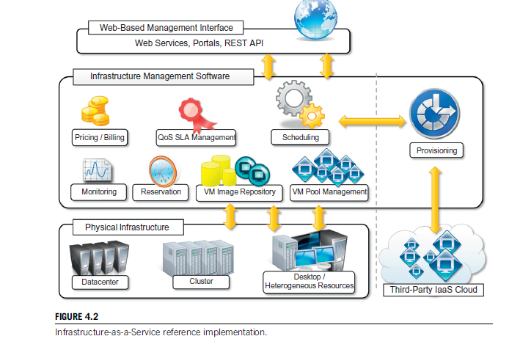
1.1. Infrastructure- and hardware-as-a-service contd…

Slide 12
1.1. Infrastructure- and hardware-as-a-service contd…
It is possible to distinguish three principal layers:
The physical infrastructure
The software management infrastructure
The user interface
Physical infrastructure
The bottom layer is composed of the physical infrastructure, on top of which the management layer operates.
The infrastructure can be of different types; the specific infrastructure used depends on the specific use of the cloud.
A service provider will most likely use a massive data center containing hundreds or thousands of nodes.
A cloud infrastructure developed in house, in a small or medium-sized enterprise or within a university department, will most likely rely on a cluster.
At the bottom of the scale it is also possible to consider a heterogeneous environment where different types of resources—PCs, workstations, and clusters—can be aggregated.

Slide 13
1.1. Infrastructure- and hardware-as-a-service contd…
The user interface
At the top layer the user interface provides access to the services exposed by the software management infrastructure. Such an interface is generally based on Web 2.0 technologies: Web services, RESTful APIs, and mash-ups.
These technologies allow either applications or final users to access the services exposed by the underlying infrastructure.
The software management infrastructure
The core features of an IaaS solution are implemented in the infrastructure management software layer.
In particular, management of the virtual machines is the most important function performed by this layer.
A central role is played by the scheduler, which is in charge of allocating the execution of virtual machine instances.

Slide 14
1.1. Infrastructure- and hardware-as-a-service contd…
The scheduler interacts with the other components that perform a variety of tasks:
The pricing and billing component takes care of the cost of executing each virtual machine instance and maintains data that will be used to charge the user.
The monitoring component tracks the execution of each virtual machine instance and maintains data required for reporting and analysing the performance of the system.
The reservation component stores the information of all the virtual machine instances that have been executed or that will be executed in the future.
If support for QoS-based execution is provided, a QoS/SLA management component will maintain a repository of all the SLAs made with the users; together with the monitoring component, this component is used to ensure that a given virtual machine instance is executed with the desired quality of service.

Slide 15
1.1. Infrastructure- and hardware-as-a-service contd…
The VM repository component provides a catalogue of virtual machine images that users can use to create virtual instances. Some implementations also allow users to upload their specific virtual machine images.
A VM pool manager component is responsible for keeping track of all the live instances.
Finally, if the system supports the integration of additional resources belonging to a third-party IaaS provider, a provisioning component interacts with the scheduler to provide a virtual machine instance that is external to the local physical infrastructure directly managed by the pool.

Slide 16
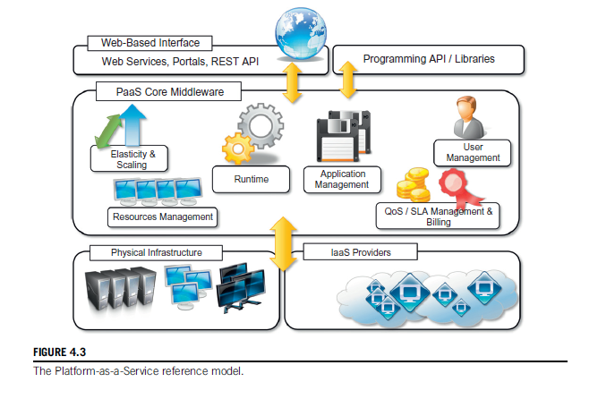
1.2 PLATFORM AS A SERVICE
Platform-as-a-Service (PaaS) solutions provide a development and deployment platform for running applications in the cloud. They constitute the middleware on top of which applications are built

Slide 17
1.2 PLATFORM AS A SERVICE
Application management is the core functionality of the middleware.
PaaS implementations provide applications with a runtime environment and do not expose any service for managing the underlying infrastructure.
They automate the process of deploying applications to the infrastructure, configuring application components, provisioning and configuring supporting technologies such as load balancers and databases, and managing system change based on policies set by the user.
The core middleware is in charge of managing the resources and scaling applications on demand or automatically, according to the commitments made with users.
From a user point of view, the core middleware exposes interfaces that allow programming and deploying applications on the cloud. These can be in the form of a Web-based interface or in the form of programming APIs and libraries.
PaaS solutions can offer middleware for developing applications together with the infrastructure or simply provide users with the software that is installed on the user premises.
In the first case, the PaaS provider also owns large data centers where applications are executed; in the second case, referred is Pure PaaS, the middleware constitutes the core value of the offering. It is also possible to have vendors that deliver both middleware and infrastructure and ship only the middleware for private installations.

Slide 18
1.2 PLATFORM AS A SERVICE CONTD…
 |  |  | Vendors and
Category | Description | Product Type | Products
PaaS-I | Runtime environment with Web-hosted | Middleware + Infrastructure | Force.com
 | application development platform. Rapid | Middleware + Infrastructure | Longjump
 | application prototyping.
PaaS-II | Runtime environment for scaling Web | Middleware + Infrastructure | Google AppEngine
 | applications. The runtime could be | Middleware | AppScale
 | enhanced by additional components that | Middleware + Infrastructure | Heroku
 | provide scaling capabilities. | Middleware+ Infrastructure | Engine Yard
 |  | Middleware +Infrastructure | Joyent Smart
 |  | Middleware | Platform
 |  |  | GigaSpaces XAP
PaaS-III | Middleware and programming model for | Middleware + Infrastructure | Microsoft Azure
 | developing distributed applications in the | Middleware | DataSynapse
 | cloud. | Middleware | Cloud IQ
 |  | Middleware | Manjrasof Aneka
 |  | Middleware | Apprenda
 |  | Middleware | SaaSGrid
 |  |  | GigaSpaces
 |  |  | DataGrid

Slide 19
1.3. software as a service
Software-as-a-Service (SaaS) is a software delivery model that provides access to applications through the Internet as a Web-based service.
It provides a means to free users from complex hardware and software management by offloading such tasks to third parties, which build applications accessible to multiple users through a Web browser.
In this scenario, customers neither need install anything on their premises nor have to pay considerable up-front costs to purchase the software and the required licenses.
They simply access the application website, enter their credentials and billing details, and can instantly use the application, which, in most of the cases, can be further customized for their needs.
On the provider side, the specific details and features of each customer’s application are maintained in the infrastructure and made available on demand.

Slide 20
1.3. software as a service contd…
SaaS applications are naturally multitenant. Multitenancy, which is a feature of SaaS compared to traditional packaged software, allows providers to centralize and sustain the effort of managing large hardware infrastructures, maintaining and upgrading applications transparently to the users, and optimizing resources by sharing the costs among the large user base.
ASPs already had some of the core characteristics of SaaS:
The product sold to customer is application access.
The application is centrally managed.
The service delivered is one-to-many.
The service delivered is an integrated solution delivered on the contract, which means provided as promised.

Slide 21
1.3. software as a service contd…
Software-as-a-Service applications can serve different needs. CRM, ERP, and social networking applications are definitely the most popular ones.
SalesForce.com is probably the most successful and popular example of a CRM service. It provides a wide range of services for applications: customer relationship and human resource management, enterprise resource planning, and many other features.
Another important class of popular SaaS applications comprises social networking applications such as Facebook and professional networking sites such as LinkedIn. Other than providing the basic features of networking, they allow incorporating and extending their capabilities by integrating third-party applications.
Office automation applications are also an important representative for SaaS applications: Google Documents and Zoho Office are examples of Web-based applications that aim to address all user needs for documents, spreadsheets, and presentation management. They offer a Web-based interface for creating, managing, and modifying documents that can be easily shared among users and made accessible from anywhere.

Slide 22
2. Deployment models
A more useful classification is given according to the administrative domain of a cloud: It identifies the boundaries within which cloud computing services are implemented, provides hints on the underlying infrastructure adopted to support such services, and qualifies them. It is then possible to differentiate four different types of cloud:
Public clouds: The cloud is open to the wider public.
Private clouds: The cloud is implemented within the private premises of an institution and generally made accessible to the members of the institution or a subset of them.
Hybrid or Heterogeneous clouds: The cloud is a combination of the two previous solutions and most likely identifies a private cloud that has been augmented with resources or services hosted in a public cloud.
Community clouds: The cloud is characterized by a multi-administrative domain involving different deployment models (public, private, and hybrid), and it is specifically designed to address the needs of a specific industry

Slide 23
2.1 Public clouds
They offer solutions for minimizing IT infrastructure costs and serve as a viable option for handling peak loads on the local infrastructure.
They have become an interesting option for small enterprises, which are able to start their businesses without large up-front investments by completely relying on public infrastructure for their IT needs.
Public clouds are used both to completely replace the IT infrastructure of enterprises and to extend it when it is required.
A fundamental characteristic of public clouds is multitenancy. A public cloud is meant to serve a multitude of users, not a single customer.
QoS management is a very important aspect of public clouds. Hence, a significant portion of the software infrastructure is devoted to monitoring the cloud resources, to bill them according to the contract made with the user, and to keep a complete history of cloud usage for each customer.
A public cloud can offer any kind of service: infrastructure, platform, or applications. For example, Amazon EC2 is a public cloud that provides infrastructure as a service; Google AppEngine is a public cloud that provides an application development platform as a service; and SalesForce.com is a public cloud that provides software as a service

Slide 24
2.1 Public clouds contd…
Public clouds can be composed of geographically dispersed data centers to share the load of users and better serve them according to their locations.
For example, Amazon Web Services has data centers installed in the United States, Europe, Singapore, and Australia; they allow their customers to choose between three different regions: us-west-1, us-east-1, or eu-west-1. Such regions are priced differently and are further divided into availability zones, which map to specific data centers.

Slide 25
2.2. Private Cloud
Public clouds are appealing and provide a viable option to cut IT costs and reduce capital expenses, but they are not applicable in all scenarios.
In the case of public clouds, the provider is in control of the infrastructure and, eventually, of the customers’ core logic and sensitive data. Even though there could be regulatory procedure in place that guarantees fair management and respect of the customer’s privacy, this condition can still be perceived as a threat or as an unacceptable risk that some organizations are not willing to take
Institutions such as government and military agencies will not consider public clouds as an option for processing or storing their sensitive data. The risk of a breach in the security infrastructure of the provider could expose such information to others; this could simply be considered unacceptable.
For Example: USA PATRIOT Act provides its government and other agencies with virtually limitless powers to access information, including that belonging to any company that stores information in the U.S. territory
Notes:
Public clouds are appealing and provide a viable option to cut IT costs and reduce capital expenses, but they are not applicable in all scenarios. For example, a very common critique to the use of cloud computing in its canonical implementation is the loss of control. In the case of public clouds, the provider is in control of the infrastructure and, eventually, of the customers’ core logic and sen-sitive data. Even though there could be regulatory procedure in place that guarantees fair manage-ment and respect of the customer’s privacy, this condition can still be perceived as a threat or as an unacceptable risk that some organizations are not willing to take. In particular, institutions such as government and military agencies will not consider public clouds as an option for processing or storing their sensitive data. The risk of a breach in the security infrastructure of the provider could expose such information to others; this could simply be considered unacceptable.
More precisely, the geographical location of a datacenter generally determines the regulations that are applied to management of digital information. As a result, according to the specific location of data, some sensitive information can be made accessible to government agencies or even considered outside the law if processed with specific cryptographic techniques. For example, the USA PATRIOT Act⁵ provides its government and other agencies with virtually limitless powers to access information, including that belonging to any company that stores information in the U.S. territory. Finally, existing enterprises that have large computing infra-structures or large installed bases of software do not simply want to switch to public clouds, but they use the existing IT resources and optimize their revenue. All these aspects make the use of a public computing infrastructure not always possible. Yet the general idea supported by the cloud computing vision can still be attractive. More specifically, having an infrastructure able to deliver IT services on demand can still be a winning solution, even when implemented within the private premises of an institution. This idea led to the diffusion of private clouds, which are similar to pub-lic clouds, but their resource-provisioning model is limited within the boundaries of an organization.

Slide 26
2.2. Private Cloud contd…
Private clouds are virtual distributed systems that rely on a private infrastructure and provide internal users with dynamic provisioning of computing resources.
Instead of a pay-as-you-go model as in public clouds, there could be other schemes in place, taking into account the usage of the cloud and proportionally billing the different departments or sections of an enterprise
Private clouds have the advantage of keeping the core business operations in-house by relying on the existing IT infrastructure and reducing the burden of maintaining it once the cloud has been set up.
A Forrester report on the benefits of delivering in-house cloud computing solutions for enter-prises highlighted some of the key advantages of using a private cloud computing infrastructure:
Customer information protection
Infrastructure ensuring SLAs.
Compliance with standard procedures and operations.
Notes:
Private clouds are virtual distributed systems that rely on a private infrastructure and provide internal users with dynamic provisioning of computing resources. Instead of a pay-as-you-go model as in public clouds, there could be other schemes in place, taking into account the usage of the cloud and proportionally billing the different departments or sections of an enterprise. Private clouds have the advantage of keeping the core business operations in-house by relying on the exist-ing IT infrastructure and reducing the burden of maintaining it once the cloud has been set up. In this scenario, security concerns are less critical, since sensitive information does not flow out of the private infrastructure. Moreover, existing IT resources can be better utilized because the private cloud can provide services to a different range of users. Another interesting opportunity that comes with private clouds is the possibility of testing applications and systems at a comparatively lower price rather than public clouds before deploying them on the public virtual infrastructure. A Forrester report on the benefits of delivering in-house cloud computing solutions for enter-prises highlighted some of the key advantages of using a private cloud computing infrastructure:
Customer information protection. Despite assurances by the public cloud leaders about security, few provide satisfactory disclosure or have long enough histories with their cloud offerings to provide warranties about the specific level of security put in place on their systems. In-house security is easier to maintain and rely on.
Infrastructure ensuring SLAs. Quality of service implies specific operations such as appropriate clustering and failover, data replication, system monitoring and maintenance, and disaster recovery, and other uptime services can be commensurate to the application needs. Although public cloud vendors provide some of these features, not all of them are available as needed.
Compliance with standard procedures and operations. If organizations are subject to third-party compliance standards, specific procedures have to be put in place when deploying and executing applications. This could be not possible in the case of the virtual public infrastructure.

Slide 27
2.3. Hybrid Cloud
Public clouds are large software and hardware infrastructures that have a capability that is huge enough to serve the needs of multiple users, but they suffer from security threats and administrative pitfalls.
Private clouds are the perfect solution when it is necessary to keep the processing of information within an enterprise’s premises or it is necessary to use the existing hardware and software infrastructure. One of the major drawbacks of private deployments is the inability to scale on demand and to efficiently address peak loads.
A hybrid solution could be an interesting opportunity for taking advantage of the best of the private and public worlds. This led to the development and diffusion of hybrid clouds.

Slide 28
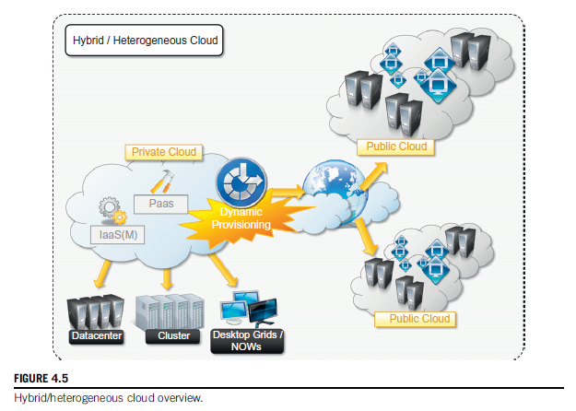
2.3. Hybrid Cloud contd…
Hybrid clouds allow enterprises to exploit existing IT infrastructures, maintain sensitive information within the premises, and naturally grow and shrink by provisioning external resources and releasing them when they’re no longer needed. Security concerns are then only limited to the public portion of the cloud that can be used to perform operations with less stringent constraints but that are still part of the system workload.

Slide 29
2.3. Hybrid Cloud contd…
It is a heterogeneous distributed system resulting from a private cloud that integrates additional services or resources from one or more public clouds. For this reason they are also called heterogeneous clouds.
Whereas the concept of hybrid cloud is general, it mostly applies to IT infrastructure rather than software services
Infrastructure management software and PaaS solutions are the building blocks for deploying and managing hybrid clouds.
Infrastructure management software such as OpenNebula already exposes the capability of integrating resources from public clouds such as Amazon EC2. Other examples include InterGrid etc.
Notes:
Infrastructure management software such as OpenNebula already exposes the capability of inte-grating resources from public clouds such as Amazon EC2. In this case the virtual machine obtained from the public infrastructure is managed as all the other virtual machine instances main-tained locally. What is missing is then an advanced scheduling engine that’s able to differentiate these resources and provide smart allocations by taking into account the budget available to extend the existing infrastructure. In the case of OpenNebula, advanced schedulers such as Haizea can be integrated to provide cost-based scheduling. A different approach is taken by InterGrid. This is essentially a distributed scheduling engine that manages the allocation of virtual machines in a col-lection of peer networks. Such networks can be represented by a local cluster, a gateway to a public cloud, or a combination of the two. Once a request is submitted to one of the InterGrid gateways, it is served by possibly allocating virtual instances in all the peered networks, and the allocation of requests is performed by taking into account the user budget and the peering arrangements between networks.

Slide 30
2.4. Community Cloud
Community clouds are distributed systems created by integrating the services of different clouds to address the specific needs of an industry, a community, or a business sector. The National Institute of Standards and Technologies (NIST) characterizes community clouds as follows:
The infrastructure is shared by several organizations and supports a specific community that has shared concerns (e.g., mission, security requirements, policy, and compliance considerations). It may be managed by the organizations or a third party and may exist on premise or off premise.
The users of a specific community cloud fall into a well-identified community, sharing the same concerns or needs; they can be government bodies, industries, or even simple users, but all of them focus on the same issues for their interaction with the cloud.
This is a different scenario than public clouds, which serve a multitude of users with different needs. Community clouds are also different from private clouds, where the services are generally delivered within the institution that owns the cloud.
From an architectural point of view, a community cloud is most likely implemented over multiple administrative domains. This means that different organizations such as government bodies, private enterprises, research organizations, and even public virtual infrastructure providers contribute with their resources to build the cloud infrastructure.

Slide 31
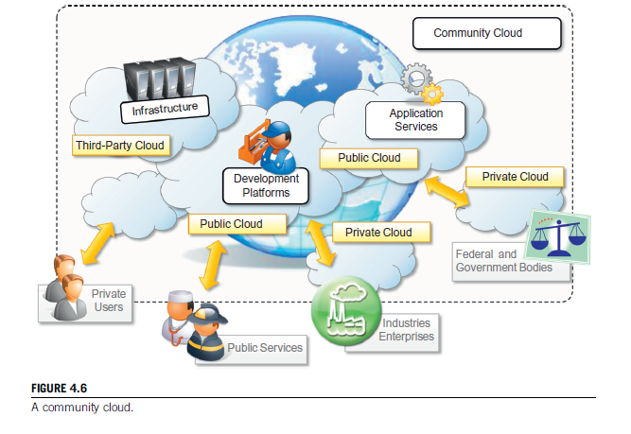
2.4. Community Cloud contd…
Candidate sectors for community clouds are as follows:
Media Industry
Healthcare Industry
Energy and other core industries
Public sector
Scientific Research
Notes:
Candidate sectors for community clouds are as follows:
Media industry. In the media industry, companies are looking for low-cost, agile, and simple solutions to improve the efficiency of content production. Most media productions involve an extended ecosystem of partners. In particular, the creation of digital content is the outcome of a collaborative process that includes movement of large data, massive compute-intensive rendering tasks, and complex workflow executions. Community clouds can provide a shared environment where services can facilitate business-to-business collaboration and offer the horsepower in terms of aggregate bandwidth, CPU, and storage required to efficiently support media production.
Healthcare industry. In the healthcare industry, there are different scenarios in which community clouds could be of use. In particular, community clouds can provide a global platform on which to share information and knowledge without revealing sensitive data maintained within the private infrastructure. The naturally hybrid deployment model of community clouds can easily support the storing of patient-related data in a private cloud while using the shared infrastructure for noncritical services and automating processes within hospitals.
Energy and other core industries. In these sectors, community clouds can bundle the comprehensive set of solutions that together vertically address management, deployment, and orchestration of services and operations. Since these industries involve different providers, vendors, and organizations, a community cloud can provide the right type of infrastructure to create an open and fair market.
Public sector. Legal and political restrictions in the public sector can limit the adoption of public cloud offerings. Moreover, governmental processes involve several institutions and agencies and are aimed at providing strategic solutions at local, national, and international administrative levels. They involve business-to-administration, citizen-to-administration, and possibly business-to-business processes. Some examples include invoice approval, infrastructure planning, and public hearings. A community cloud can constitute the optimal venue to provide a distributed environment in which to create a communication platform for performing such operations.
Scientific research. Science clouds are an interesting example of community clouds. In this case, the common interest driving different organizations sharing a large distributed infrastructure is scientific computing.

